Slide 1
Race and the Role of Government
Changing the terrain of public discourse
Anika Fassia – afassia@publicworks.org
Patrick Bresette – pbresette@publicworks.org
www.publicworks.org
Notes:
Slide Narrative:
Clarify the purpose FIRST.
Race Matters ppt – great examples of structural racism
We are supposed to be for the common good yet we are also working in a system setup to compete with one another. Zero-sum game.
Explain the connection between race and equity in the beginning – assumes there is an understanding.
This assumes that people believe that if I benefit – my entire community benefits. Are there examples, beyond economic benefits? Manuel Pastor makes that connections – using some data, but not relying on the data. Countries with lower rates of inequality have higher rates of economic prosperity – classic example is public health – but tricky to not otherize. Paid sick leave campaign in Oregon is a great example.
Notion of prosperity grid – Frameworks. Another way to make the connection.
This America21 – differential access to capital – definition of structural racism without talking about race?
It feels really smart/intellectual – but may not land with organizers – really unpack systems thinking (campaign examples), circle of concern, framing public issues.
What is the purpose and who is the audience – as a community organizer – this is not going to sell to them. But the messaging piece would be more helpful.
We need to unpack more of the examples – shared regional benefit (CSI).
Some organizers may view systems differently (beyond the choir) – bridging an academic view of systems thinking.
Theory should be driving practice – having people ask themselves – how am I currently describing – is a way that people can internalize it. You need to start with theory – need a worksheet.
How do you present this authentically in front of systemically less privileged audience? More dialogue? We want to explicitly acknowledge that issues of race are there when rebuilding trust for the role of government.
Themes? Individual vs. Systemic.
The liberty example – I want to hear more about structural inequities – underlines so much – most people don’t really know. Depending on who you are talking about –
Still implications from the past and current examples – for example the redlining example. Not the same visceral reaction to this portion as the other AC pieces – I felt l was spoonfed the other concepts. Add the New Mexico enchantment slide. Still feels very META and higher level. More before and after examples.
Not seeing the connection between structural inequities and the role of government
Who is your audience? Pull those audiences and make those more concrete. You are getting the wonkiest version – and how do we bring down some of these parts – translate it each for the government.
Can’t talk about race and not otherize – you can disaggregate data around race. How do we translate this for public manager audience – it’s okay to talk about race? People may confuse ‘don’t otherize’ as not talking about race. Be very clear. Many assumptions are being made about what people know when they enter the room. Read the executive summary of the Oregon Facing Race Legislative card – case study for OR.
It’s about order – articulating that in the examples. It’s not whether you talk about race or not but how you lead into the conversation (Frank Gilliam).
What is your expectation for the outcome of this presentation given your audience?
Questions PB asks:
Organizing crowd?
What are the themes you are dealing with?
Over the last 10 years as we’ve engaged with our partners in the field, we realized that we needed to thoughtfully and explicitly understand and work through the complex intersection of race and the role of government. With this in mind, we have articulated a set of questions and ideas that we believe to be the foundation for a framework moving forward.
Make notes for where I want to stop and ask for feedback – for Monday’s version
Reading list – last slide – create a document with things from quotes, etc. Stuff we want people to read ahead of time.

Slide 2
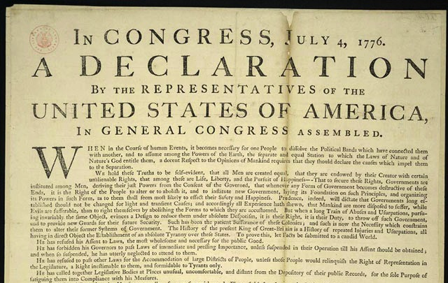
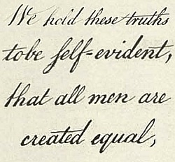
Race and the Role of Government
Living up to this promise has required constant attention to the intersection of race and the role of government
Notes:
SLIDE Narrative:
Our history is embedded with contradictions – starting with our founding documents. Our declaration that all men are created equal yet are not seen or treated as equal. As we have worked to perfect our democracy and our founding principles, it has required our constant attention. Living up to this promise has required constant attention to the intersection of race and the role of government.

Slide 3
Notes:
SLIDE Narrative:
What’s the purpose/goal of our exploration?
"an important goal/role of government has been to addressing inequities and advance equality, improving justice for all people . . . and we have in fact made steady - if fitful - progress in this direction"
We’ve got this legacy, even in our founding documents, profess that all men are created equal, even today, on our stamps, to claim equality and justice as 2 key principles – how do we live up to it today.

Slide 4
How do we change the terrain on which discussions about our issues occur?
Notes:
SLIDE Narrative: (Does it sound like we address and acknowledge the different ways people are dismantling racism?)
There are many different types of conversations about race. Knowing what we know and don’t know about the intersection of race and the role of government, what kind of conversation do we want to have moving forward?
Our partners and allies across the country are working to dismantle racialized systems and counter the negative impacts of racism in their communities. Some are focused on healing – bringing communities and leaders together in a facilitated dialogue to hear each others stories and to heal from our past and present struggles. Some are confronting the race wedge head on, calling out our elected leaders, the media and so forth. All of these are valuable and play and important role in pushing along the conversation about race and racism . . .the particular conversation about race and the role of government is the one we are digging into.
With the public seeing ‘we the people’ in different ways, we wish to change the terrain of public discourse around the intersection of race and the role of government in order to build broad support for the public systems we all benefit from to ensure a quality of life for all Americans.

Slide 5
Conversations in Context
Policy debates
Program design
Political conversations
Civic Participation
Notes:
SLIDE Narrative:
Conversations about the intersection of race and the role of government can and have come up in many ways. It is important to be aware of the situations in which this intersection arises and how it can impact the outcomes of public systems and civic participation. Some examples include:
In policy debates that impact racial equity – whether it be positively or negatively
In program design and delivery to address racial equity or how particular programs stigmatize purposefully or inadvertently
In political conversations that use explicit and implicit cues to tie certain actions of government to racialized or outright racist attitudes (welfare queen, food stamp president, etc.)
And in the efforts to engage communities of color in basic civic participation and/or active reclaiming of government to its role in promoting equity and justice

Slide 6
Race and the Role of Government
How do we:
Recognize the historical and structural racism that has been imbedded in public systems and continues to exacerbate inequities, but also realize that it is through government that our most important strides towards justice and equity have been realized.
Understand that some anti-government sentiment is directly tied up in racial bias, both implicit and explicit
Find a way to uphold (at least aspirationally) the need for robust, supported and correctly-focused public systems as tools for shared prosperity and racial equity, and
Engage communities of color in the effort to reclaim and rebuild government
Notes:
SLIDE Narrative: (Are we missing something big in our questions of inquiry?)
We want to acknowledge that no direct research has been done on the intersection of race and the role of government. However, people live this – they struggle with its implications everyday– what are the lessons from our partners in the field that could inform our work on this intersection together?
Given that our history is marked with contradicting statements and actions about the intersection of race and the role of government, the different conversations that can be had on race, and the many cases in which this intersection has real impacts on our communities and public systems, how do we…(read through slide)
Recognize the historical and structural racism that has been imbedded in public systems and continues to exacerbate inequities, but also realize that it is through government that our most important strides towards justice and equity have been realized.
Understand that some anti-government sentiment is directly tied up in racial bias, both implicit and explicit
Find a way to uphold (at least aspirationally) the need for robust, supported and correctly-focused public systems as tools for shared prosperity and racial equity, and
Engage communities of color in the effort to reclaim and rebuild government
While also engaging all Americans in these questions

Slide 7
While also engaging all Americans in these questions….
Notes:
SLIDE 6 Narrative:
While also engaging all Americans in these questions

Slide 8
A Winding Road
Color Blind(ed)?
The end of “Big Government”
Immigration and Nationality Act
The Civil Rights Era
The New Deal
Jim Crow
Reconstruction
Emancipation
Trail of Tears
Notes:
SLIDE Narrative: (Is this historical perspective helpful? Does it minimize/simplify complex parts of our history?)
In reference to the background reading you were given on the history of public debate on race and the role of government – we think it is important to understand how discourse and events over time has brought us to the conversations about race we are having today. While the article focused on the African American experience with the role of government we must note the many other moments in our history where communities of color have been oppressed and marginalized through our government.
Our founding principles demonstrate the competing definitions of equality we held as a nation and the ways in which we chose to live them.
This contradiction was perceived to be resolved through the emancipation of slaves. However, we know that racism and the impacts of slavery just took on a different form.
Nation Building was met with the tearing down of our country’s first inhabitants. government policies of assimilation, relocation and genocide created questions for Native Americans about their own identity and their sense of belonging in mainstream society; questions over the power they have to self-govern; questions about preserving their families and cultures; how to make a living on isolated reservations and stay healthy in the face of long-term historic trauma. The Trail of Tears confirmed and became the legalized pattern in the federal government's dealings with the Native tribes during the drive to settle the West.
The Reconstruction Era began a time where the nation was sharply divided between the role of government. Was it governments role to redistribute revenue and intervene in social and economic issues? The fall of the Reconstruction era was greeted with the rise of “State’s Rights”. We see challenges of this era being echoed in the public debates today. What is the most appropriate role for government?
During Jim Crow we see the institutionalization of racist practices. From legalized segregation to the civic disenfranchisement of African Americans.
The Great Depression marked an opportunity to discuss how government could be used a tool to address the rise in economic and social injustice. The New Deal restored faith in the role of government and its ability to increase opportunities among all communities – albeit the New Deal did in fact leave out many communities of color through the GI Bill and other programs – it also increased employment and educational opportunities at the same time. - Nevertheless, African Americans took opportunities created by government programs in the 1930s to: Take care of their families, Earn a living wage, Be educated persons, Hold professional positions, Possess economic security, Receive health care, Possess cash‐money and purchase goods, Engage in civic life, Vote and Have a publicly acknowledged history.
The Civil Rights movement began with the charge that it was possible to work within American traditions to achieve racial justice while also convincing all Americans that we all had a stake in supporting the expansion of democracy and freedom.
The Immigration and Nationality Act of 1965 removed the national-origin quotas which led to an influx of immigration from many different countries and cultures. This significantly changed the demographic make-up of the United States and the conversations around our national identity as Americans in the decades that followed.
It is during the Reagan Administration that we see a reversal in governments role as a tool for social justice. By pitting the white working class and conservatives (us vs. them) against the perceived motives of the democratic party. Here we see the stigmatization of all government programs by using race as a wedge to divide communities and decreased support for public systems that benefited everyone.
Today we here the term “colorblind” thrown around, that a rising tide lifts all boats. Pushback on using colorblind methods to improve outcomes is the idea that because of our history and institutional racism, it is not possible to improve opportunities and remove barriers without understanding and taking into consideration that we are not working with a level playing field. We have also seen a rise in anti-immigration sentiment, defining communities as not American and as “illegal” inhabitants of this country. The presidential debate has been charged with implicit and explicit racialization of public systems and the role of government on issues of race.

Slide 9
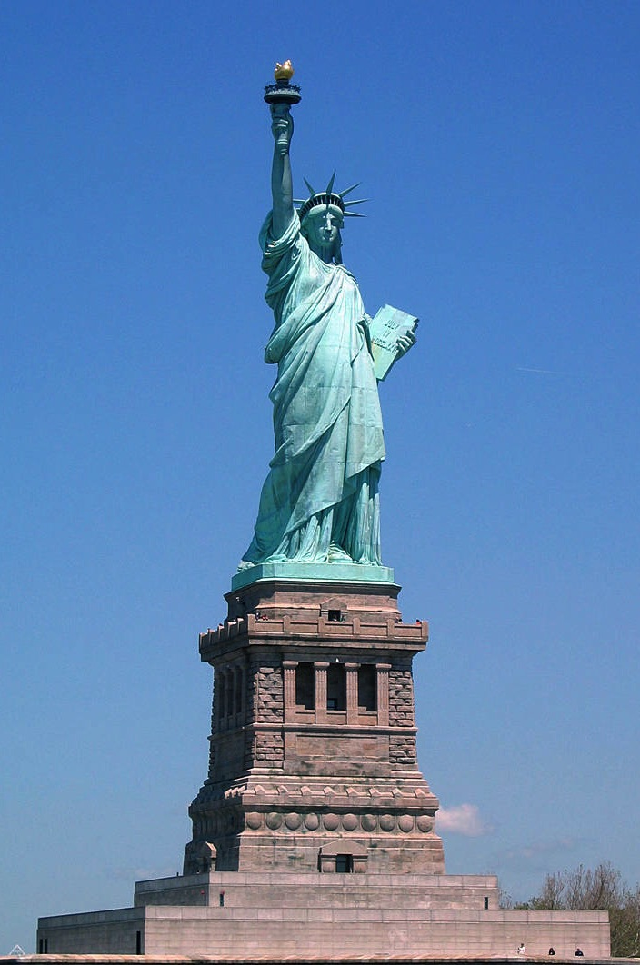
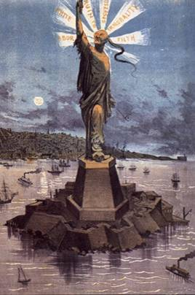
Notes:
SLIDE Narrative:
Making invisible communities visible (Native American community). Janet’s housing example from NEA?
These contradictions for immigrants both invited people in and excluded people at the same time – merge liberty images.
Here is a country on immigration – even that has been fraught with contradictions. We have this mother of exiles
Left SIDE: Mother of Exiles
"Give me your tired, your poor, your huddled masses yearning to breathe free, the wretched refuse of your teeming shore, send these, the homeless, tempest-tost to me, I lift my lamp beside the golden door!“- 1886
“Americans have always been ambivalent about immigration, with realistic concerns bumping into altruistic, even romantic notions. The romance is summed up in the inscription on the Statue of Liberty, erected in 1886, proclaiming the famous lines ‘give us your tired, your poor, your huddled masses yearning to breathe free.’ “
- Public Agenda
http://www.publicagenda.org/citizen/issueguides/immigration
Right SIDE: Four Years Earlier, The Chinese Exclusion Act of 1882. Specifically excluding "paupers, ex-convicts, mental defectives and Chinese."
“The ambivalence was expressed a mere four years earlier, when Congress enacted the first immigration restrictions, specifically excluding ‘paupers, ex-convicts, mental defectives and Chinese.’ That was at the beginning of the greatest wave of immigration in American history, which brought in 18 million new citizens, diversified U.S. society and gave us the enduring analogy of the ''melting pot.
- Public Agenda
http://www.publicagenda.org/citizen/issueguides/immigration

Slide 10
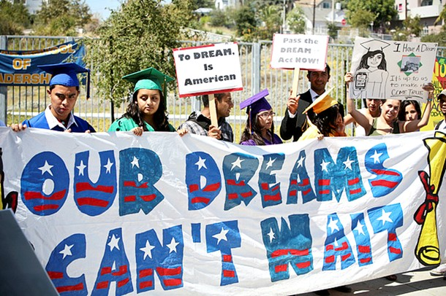
Notes:
SLIDE Narrative:
So throughout our history we’ve seen our government being used as a tool for justice and for oppression/inequality THAT STILL HAVE IMPLICATIONS TODAY.
Through our government we’ve guaranteed youth from all over the world for opportunity a chance to fulfill their highest potential by giving them temporary relief from deportation. However, it is through our government we’ve also seen some of the most racialized anti-immigration legislation proposed and passed, including SB1070.
Another example, through our government we’ve implemented laws securing fair housing, but we’ve also seen our government used to segregate communities through the practice of ‘redlining’. Redlining is the process in which lenders would do not offer communities of color housing in neighborhoods that had access to greater resources. The (Home Owners' Loan Corporation, created in 1933, introduced the practice of redlining, marking in red ink swaths of cities in which it would not lend. It rated white neighborhoods as the least risky and black neighborhoods as the most. It would not lend to a black person seeking to buy in a white neighborhood, or vice versa. When the Federal Housing Administration opened its doors a year later, it adopted the same practices. As a result, 98 percent of the loans the FHA insured between 1934 and 1962 went to white borrowers. The policies encouraged white flight as even neighborhoods with small numbers of African Americans were rated as "hazardous." White residents who didn't mind black neighbors found their home values decreasing as the government refused to insure mortgages for new buyers.)

Slide 11
Notes:
SLIDE Narrative:
So throughout our history we’ve seen our government being used as a tool for justice and for oppression/inequality.
Through our government we’ve guaranteed youth from all over the world for opportunity a chance to fulfill their highest potential by giving them temporary relief from deportation. However, it is through our government we’ve also seen some of the most racialized anti-immigration legislation proposed and passed, including SB1070.
Another example, through our government we’ve implemented laws securing fair housing, but we’ve also seen our government used to segregate communities through the practice of ‘redlining’. Redlining is the process in which lenders would do not offer communities of color housing in neighborhoods that had access to greater resources. The (Home Owners' Loan Corporation, created in 1933, introduced the practice of redlining, marking in red ink swaths of cities in which it would not lend. It rated white neighborhoods as the least risky and black neighborhoods as the most. It would not lend to a black person seeking to buy in a white neighborhood, or vice versa. When the Federal Housing Administration opened its doors a year later, it adopted the same practices. As a result, 98 percent of the loans the FHA insured between 1934 and 1962 went to white borrowers. The policies encouraged white flight as even neighborhoods with small numbers of African Americans were rated as "hazardous." White residents who didn't mind black neighbors found their home values decreasing as the government refused to insure mortgages for new buyers.)

Slide 12
Notes:
SLIDE Narrative:
So throughout our history we’ve seen our government being used as a tool for justice and for oppression/inequality.
Through our government we’ve guaranteed youth from all over the world for opportunity a chance to fulfill their highest potential by giving them temporary relief from deportation. However, it is through our government we’ve also seen some of the most racialized anti-immigration legislation proposed and passed, including SB1070.
Another example, through our government we’ve implemented laws securing fair housing, but we’ve also seen our government used to segregate communities through the practice of ‘redlining’. Redlining is the process in which lenders would do not offer communities of color housing in neighborhoods that had access to greater resources. The (Home Owners' Loan Corporation, created in 1933, introduced the practice of redlining, marking in red ink swaths of cities in which it would not lend. It rated white neighborhoods as the least risky and black neighborhoods as the most. It would not lend to a black person seeking to buy in a white neighborhood, or vice versa. When the Federal Housing Administration opened its doors a year later, it adopted the same practices. As a result, 98 percent of the loans the FHA insured between 1934 and 1962 went to white borrowers. The policies encouraged white flight as even neighborhoods with small numbers of African Americans were rated as "hazardous." White residents who didn't mind black neighbors found their home values decreasing as the government refused to insure mortgages for new buyers.)

Slide 13
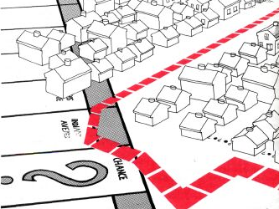
Notes:
SLIDE Narrative:
So throughout our history we’ve seen our government being used as a tool for justice and for oppression/inequality STILL IMPACTS US TODAY – ripple effects through communities.
Through our government we’ve guaranteed youth from all over the world for opportunity a chance to fulfill their highest potential by giving them temporary relief from deportation. However, it is through our government we’ve also seen some of the most racialized anti-immigration legislation proposed and passed, including SB1070.
Another example, through our government we’ve implemented laws securing fair housing, but we’ve also seen our government used to segregate communities through the practice of ‘redlining’. Redlining is the process in which lenders would do not offer communities of color housing in neighborhoods that had access to greater resources. The (Home Owners' Loan Corporation, created in 1933, introduced the practice of redlining, marking in red ink swaths of cities in which it would not lend. It rated white neighborhoods as the least risky and black neighborhoods as the most. It would not lend to a black person seeking to buy in a white neighborhood, or vice versa. When the Federal Housing Administration opened its doors a year later, it adopted the same practices. As a result, 98 percent of the loans the FHA insured between 1934 and 1962 went to white borrowers. The policies encouraged white flight as even neighborhoods with small numbers of African Americans were rated as "hazardous." White residents who didn't mind black neighbors found their home values decreasing as the government refused to insure mortgages for new buyers.)

Slide 14
Government can be a tool for justice or injustice. The Question is how do we reclaim it for the common good?
Notes:
SLIDE Narrative:
Our government has been and can continue to be a tool for the common good – a tool for us to come together and make great strides towards a more just and equitable society for all Americans.

Slide 15
Discussion
What are some examples of current governmental policies or systems which support racial discrimination, poverty, exploitation, segregation or other forms of racialization?
What are some examples of current governmental policies or systems that were tools to reduce racial discrimination, poverty, exploitation, segregation or other forms of racialization?
Notes:
SLIDE Narrative:
(Take notes from this discussion from participants for further examples)
Please share with us some of the ways you’ve seen and experienced government being used as a tool for justice AND for oppression/inequality?
How has this influenced the way you hear about the role of government?
When government was used for a tool for justice – what was your role? Did it require an increase in civic engagement with our government? The need for increased civic-mindedness and ownership of our systems?

Slide 16
Critiquing without Undermining
What is the core public value at stake?
Is this system living up to that core purpose or value?
If not, how do we reclaim it?
Notes:
SLIDE Narrative: (Does this and the following slides lead to a clear alternative?)
We are not here to make excuses for government and how it has and continues to exacerbate racial inequity. So how can we critique these policies and systems without undermining the unique role of government needs and must play in our communities?
By using this formula for a constructive critique, we can continue to uplift the fundamental role of government and its benefits, while still highlighting the need for change and the purpose behind it.

Slide 17
Once again the actions of our city housing department show that its all about who you know if you want to get anything done. If you don’t have some big money political clout you can’t get any response out of that bureaucratic mess of an agency. As always our working-class communities of color are just overlooked. But we are taxpayers too! We paid our share into the city coffers and we should be getting some attention and services in return.
Notes:
SLIDE Narrative:
So do you hear any of the dominant frames around government in here?

Slide 18
Once again the actions of our city housing department show that its all about who you know if you want to get anything done. If you don’t have some big money political clout you can’t get any response out of that bureaucratic mess of an agency. As always our working-class communities of color are just overlooked. But we are taxpayers too! We paid our share into the city coffers and we should be getting some attention and services in return.
Just Politics
The Bureaucratic Blob
Consumer-Thinking

Slide 19
One of the most important jobs of our city government is to help create clean and safe neighborhoods where residents can live, work and play. Unfortunately, our housing department is not living up to that essential responsibility and neighborhoods are not prioritized equitably. This system needs to address the disparities that are effecting our communities of color in order for our whole city to thrive. It is time for all of us to work together to get this public agency back on track and focused on community needs.

Slide 20
One of the most important jobs of our city government is to help create clean and safe neighborhoods where residents can live, work and play. Unfortunately, our housing department is not living up to that essential responsibility and neighborhoods are not prioritized equitably. This system needs to address the disparities that are effecting our communities of color in order for our whole city to thrive. It is time for all of us to work together to get this public agency back on track and focused on community needs.
Mission and Purpose – Why it Matters
Critique
Civic -Thinking

Slide 21
Criminal Justice Example
“Government has an important role to play in addressing crime and maintaining safe communities, but we have some major changes to make so our communities get what they need.”
“By exploring some of the common goals and values between victim-oriented groups and criminal justice reform organizations, a very different discourse could emerge about criminal justice policy that improves the outlook for all people most impacted by the system.”
-David Rogers
Notes:
SLIDE Narrative:
Right here in Oregon, the PSJ, we think, is trying to do this, reset the goals of this system.
The paper thoughtfully challenges each field to develop a more holistic vision for change. The research about the most effective ways to reduce crime is clear. We can simultaneously reduce our over-reliance on incarceration, improve public safety outcomes, and strengthen the support systems and services for people harmed by crime. We need to embrace a new public safety policy paradigm.

Slide 22
AA Strong, Robust, & Equitable Public Sector
Notes:
SLIDE Narrative:
Understanding that robust, supported and correctly-focused public systems can and have been used for shared prosperity and racial equity, part of the solution moving forward is to uphold a tool we already have and built together– our government.

Slide 23
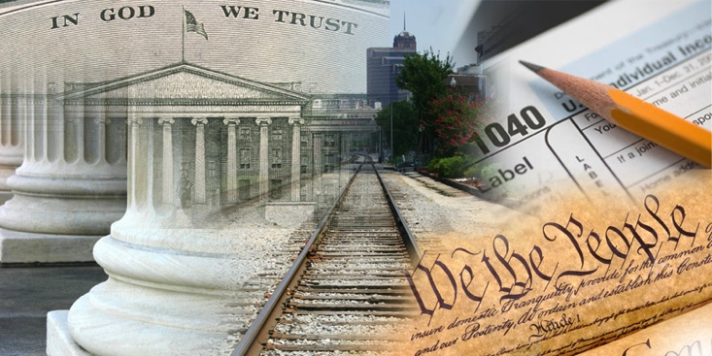
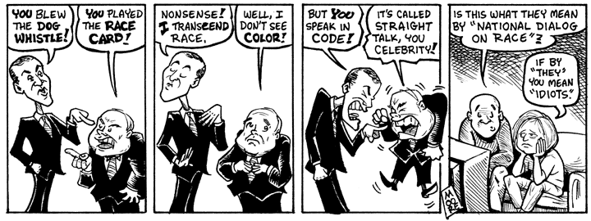
Notes:
SLIDE Narrative:
So as we think about the cultural narratives and the public’s perception around the role of government, a lot of discourse is also either directly or indirectly about race. So when we are talking to people about public programs and systems, we need to be aware of what else we may be triggering (animate to cartoon).

Slide 24
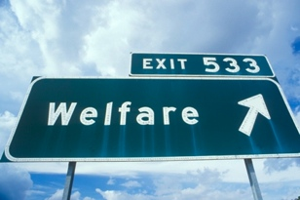
Notes:
SLIDE Narrative:
For example, we’ve seen in the news the implicit and explicit racialization of welfare - going back to the 80’s during the Reagan administration and now with President Obama’s work requirements for welfare reform and referring to the President as the “food stamp” president.
If we see our government as not for us but for them –we have lost the connection between what government is and are stuck in what it isn’t – there will be a challenge in support for public solutions that provide prosperity for all Americans as we will continue to view our relationship in a limited role – as consumers. We will want to know why we are paying into a system that we believe does not provide “us” with the same benefits as “them”.
http://campaignstops.blogs.nytimes.com/2012/08/27/making-the-election-about-race/?nl=todaysheadlines&emc=edit_th_20120827 – analytic view from NYT article
Romney’s Medicare ad is designed to undermine that relatively modest but potentially crucial advantage. It is artfully constructed to turn the issue of health care into a battle over limited tax dollars between a largely white population of seniors on Medicare and a disproportionately minority population of the currently uninsured who would get health coverage under Obamacare.
“You can tell they” — the welfare ads— “are landing punches,” Steven Law, president of the Republican super PAC American Crossroads, told the Wall Street Journal. Law’s focus group and polling research suggest that the theme is not necessarily going to work. “The economy is so lousy for middle-income Americans that the same people who chafe at the rise of welfare dependency under Obama don’t automatically default to a ‘get-a-job’ attitude — because they know there are no jobs.”
As the head of a tax-exempt 501(c)4 independent expenditure committee, Law cannot coordinate campaign strategy directly with the Romney campaign. Nonetheless, he is sending a warning. The welfare theme, Law said, “needs to be done sensitively. Right now it may be more of an economic issue than a values issue: In other words, more people on welfare is another disturbing symptom of Obama’s broken-down economy, rather than an indictment of those who are on welfare or the culture as a whole.”

Slide 25
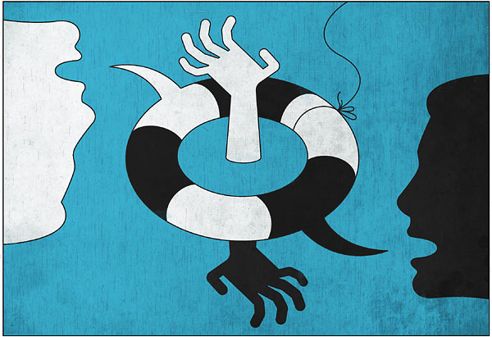
Thomas Fuchs, NYT
So how do we change the conversation about Race and the Role of Government?
Notes:
SLIDE Narrative:
Reflection/Transition point
So how do we learn from our history, the field and each other about making the case for the role of government in reducing the racialization of our public systems and programs?

Slide 26
Parallel Challenges
A Role for Government:
Individual character/luck determines outcomes
A natural economy
Everyone competes for their own interests
Not government’s role to guarantee equal outcomes
The Role of Race:
Disparities are caused by culture/behavior
Disparities are natural and/or inevitable
Us versus Them
Dependency on government creates inequities . . .
Notes:
SLIDE Narrative:
Lary- what does this mean? I am puzzled. Overarching parallels – similar challenges – discovered in our particular research in government. If it’s true – begins to point to these overarching ideas to move forward on both challenges – if you can get people there, it is easier to make the case. Needs a title: common challenges? Moving beyond and go into the solution space. Potential role for government – how does government perpetuate systemic inequities. Third column – that put the first two together in a common framing. This assumes a strong familiarity with your government research – may need a refresher. Assumes you already have government buy in.
Talk a little more about how frames get triggered without being aware – more reinforcement – example, talking about TANF – race is always in the room whether you intend it to be or not.
Through our engagement with key racial justice organizations, we have seen thematic challenges between race and the role of government. Underneath these two different conversations we see parallel hurdles to overcome. It led us to think more deeply at what is behind these conversations and the core thematic challenges that lie beyond the rhetoric.
This recognition is our bridge to the parallels between our interest in this intersection and our current mission to lift up the fundamental role of government.
Racism and racial inequality are things of the past “White people are doing worse than people of color”
Disparities caused by culture/behavior “Poor Black and Latino youth don’t do well in school because their families don’t value education”
Disparities inevitable and/or natural “Some group has to be at the bottom” or "Self-Segregation"
Programs helping people of color are unfair to Whites a.k.a. reverse discrimination

Slide 27
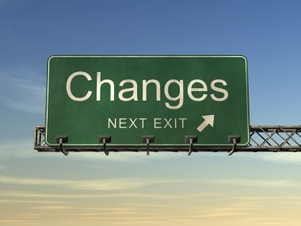
How do we start talking differently?
Notes:
SLIDE Narrative: (Do the following recommendations sound to philosophical and not tangible to accomplish in your work?)
In what ways can we move forward/begin to make changes in the way we communicate our vision, values, problems and need for solutions to further racial equity?
In our findings, we notice deep philosophical challenges around the depth of this notion of separate fates in American culture – there is compelling research that when we individualize fairness we also trigger stereotypes and ideas of who we believe to be deserving and what is fair in my personal opinion.

Slide 28
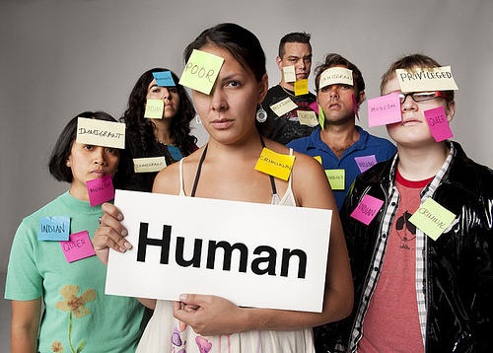
Don’t “Otherize”
Notes:
SLIDE Narrative:
People dismiss research on resiliency? I don’t believe that data. Basic framing elements that people don’t comply with facts that don’t fit into their already known knowledge. Can you add otherizing examples? Spending more time on it – concrete examples. This is such an endemic issue. Maybe use examples of how to NOT otherize. Hold onto the nuances of that particular groups that do not fall into the pitfalls of otherization.
These notions are exacerbated when we fall into the trap of “otherizing”. Whenever we label people by their temporary situations or class status, for example, only referring to the ‘beneficiaries’ of public programs rather than highlighting how public systems benefit all of us are examples of “otherizing”.
X program helps “the poor” in our state reach “self-sufficiency”
X program helps “needy kids” or “at-risk youth” in our communities
We need to start stating the problem so that it answers the “why this matters to me” question for everyone and allows people to see themselves as part of the solution.
A note/bullets instead of interdependence – even those of us can fall into that trap of otherizing – another way of thinking this is the idea that we have separate fates – helping poor children – education for students – all examples of ‘otherizing’
Link – who is benefiting and who is not – say it – it’s easy to see this as a we need to talk about government and services like welfare as benefiting our entire communities
We need to engage communities of color in the effort to reclaim and rebuild government, since so many of their own goals for themselves and their communities depend on an adequate public sector.
WHY? What’s the takeaway? The takeaway is who is often seen as the other? We all must be at the table in order to realize our interdependence.
We start this shift by shifting the way we view ourselves within our communities. Once we recognize our interdependence, we start speaking this way. We no longer ‘otherize’ each other and thus see the importance of public solutions for the common good.

Slide 29
Don’t “Otherize” : Poverty Example
Avoid Talking about “the poor” in ways that sets them apart as “not like the rest of us” . . .
Avoid the three P’s—poverty as poison, plague, or paradox—and similar distancing language
Avoid language that suggests “the poor” are categorically distinct from groups like the “working class” or “middle class”
Avoid language that implies a Sharp Break in the Prevalence of Economic Hardship at the Federal Poverty Line
Adapted from remarks by Shawn Fremstad
Notes:
SLIDE Narrative:
Assumes that people below it are different than those above it. So much focus on people ‘below the poverty line’ sets up this notion that their economic circumstances are so different than others.

Slide 30
Separate Fates: Consequences
By characterizing communities of color as the “other” and therefore, by definition, out of the system.
Allows people to place the concerns of communities of color “over there” and not connected to our entire community.
Makes it much harder to make the connection between opportunities and structural factors; and
Allows people to see our government as benefitting ‘other’ people and not all of ‘us’.
Notes:
SLIDE Narrative:
One of the consequences of otherizing – it reinforces that your fate and my fate is not linked. Portrays concerns of COC as separate/distant than our entire community. Lead into Janet example.
Define separate fates – one of the consequences of ‘otherizing’ it sets up this sense that people do not shared fate – rob from Frank Gilliam. Making the linking between otherizing and separate fates. And the consequences of that – are…Janet’s example of the Paid Sick Campaign…
Separate Fates
The final piece of the dominant race narrative is the way that minority concerns are
understood as being disconnected from the shared concerns and aspirations of the broader
society. Whites and non-whites have separate fates. The cognitive content analysis
revealed that stories about minority communities commonly portrayed minority
trajectories as distinct from those of other American lives. Sometimes the separateness is
described in fairly explicit terms:
When we otherize – we trigger notions that our fates are not linked and that what matters to someone else has no impact on me. This doesn’t allow people to see why the problem matters to them or how they can be a part of the solution – this allows people to disassociate from crucial policy decisions and civically engage on the behalf of all our communities. Here are some of the implications and consequences of speaking in terms of separate fates rather than speaking to our shared fates.

Slide 31
“Winning in the long term, though, requires getting people to think of the "other" as being inside their circles. That is entirely possible to do, as the abolition, civil rights, feminist, sexual liberation and many other movements have proven. But it takes a complement of cultural interventions alongside the political ones, advanced over five, 10, even 30 years. The cultural project has to establish the stories, images, and archetypes that prime a person to expand rather than shrink the circle of concern. That project requires us to deal with how race is lived in America, not just how it is legislated. How do we widen the circle of concern? Foster interdependence – a shared fate?”
- Rinku Sen, Applied Research Center
Notes:
SLIDE Narrative:
This quote from ARC president, Rinku Sen is illustrative of the implications of otherizing and short-term efforts to build support for specific policy proposals that in fact hurt our longer term vision of widening the circle of concern and our expanding our definition of “we”.

Slide 32
Fairness Between Places
situating the issue of fairness not in persons, but in places or systems, improves support for redistributive policy.
imbued with systems thinking, structuralizes the issue of disparities.
Notes:
SLIDE Narrative:
Transition: You can see at the end of Rinku’s piece about how we foster this shared fate, expanding our circle of concern. One of the things the research is showing – one of the ways to not trigger that we are not separate and different is to talk about disparities in places and not faces. There is something about comparing communities and what every community should have leads a more productive conversation.
Reached saturation point by Fairness between Places – clear outline of maybe how this presentation is setup?
Fairness is a sticky term – and often leads the public towards making personal and individual comparisons of who has what and why don’t I have that. When we compare places, we can highlight the inequities between the systems and structures in our communities and how inequitable investment in these structures leads to barriers to opportunity. Uplifting the systems and places that we all use and benefit from leaves less room for personal assessment on what is fair between groups of people (what people spend their $ on, who is more deserving of public benefits, etc).

Slide 33
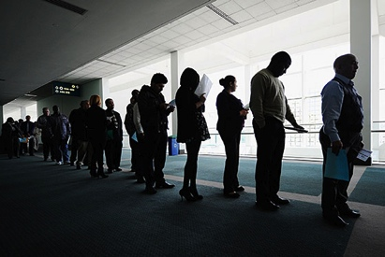
Places not Faces
Notes:
SLIDE Narrative:
One of the ways we can expand the circle of concern is to compare the inequities between the public systems and opportunities available in communities rather than individual outcomes based on race. For example, it is common to state the unemployment rate of members of the community by race rather than highlighting the lack of public infrastructure and opportunity in a community – focusing on the places and not the faces. This gives the public and readers context to the challenges communities are facing by providing a landscape rather than portrait view of the issues at hand and the public systems needed to ensure a quality of life.

Slide 34
Notes:
SLIDE Narrative:
By widening the circle of concern, we reinforce the real idea that our fates are linked. We need to reflect this throughout our communications.
We can start by using more inclusive language – “us & we”, reclaiming public structures as “our” systems that “we” built”.
We can start by describing communities by their situations as a temporary rather than a permanent state of being. For example, when we use terms like “the poor”, “at-risk”, “these communities”, not only are we otherizing, we are leaving people outside of the circle of concern. This triggering notions of a separate fate– allowing people to say ‘this is not my problem”
When we articulate the problem so it matters to everyone and so they can see themselves in the solution we not only widen the circle of concern but the issues of concern as well.

Slide 35
Interdependence Frame
The reduction of racial inequities is critical to the common good and mutually beneficial for all members of society.
Shifts away from the idea of separate and competing fates — that racial justice policies must always come at the expense of other groups.
Facilitates conversations about communities, and when talking about communities, participants were able to realize and discuss the inequities between communities.
Notes:
SLIDE Narrative:
A counter narrative to the ‘rugged individual’ frame is the one of our interdependence. Research (FW) has been done to test the success of the interdependence frame and has proved resilient in its ability to counter and balance the very prominent individualism story that is so deeply embedded in our cultural narrative – paving the way for a more productive conversation about the needs of our communities and the public systems that underpin our economy.

Slide 36
Talking Immigration: A Shared Narrative
UPHOLDING OUR VALUES
A COMMONSENSE APPROACH
MOVING FORWARD TOGETHER
Notes:
SLIDE Narrative:
http://www.tompaine.com/articles/2007/02/20/bridging_the_blackimmigrant_divide.php
Our new conversation needs a new vocabulary. That vocabulary does not include phrases often used by well-intentioned immigrant rights advocates like “we’re a nation of immigrants” or “immigrants work hard and take jobs that native born workers won’t do.” The former phrase negates the sacrifice and contribution that African Americans (as well as Native Americans) made in building our country. The latter plays into pernicious stereotypes about African Americans (as well as other low-income laborers) as loafers who’d rather get a welfare check than do an honest day’s work.
At the same time, our new conversation must move away from the idea that the rules and hierarchy of our economy and social systems are fixed, with immigrants and black folks destined to scramble for scraps at the bottom of the heap. In asking whether immigrants are good for blacks, we’ve been saying, implicitly, that immigration policy can change, but labor policy, education policy, health care policy, civil rights policy and economic policy cannot. That’s been a mistake.
So what does it mean to turn the conversation toward positive solutions that reflect our shared values and interests? It means, for example, replacing the “nation of immigrants” slogan with the more nuanced language of community—that we are all in it together, interconnected in our hopes and dreams, as well as in our successes and setbacks. As part of this narrative, we can invoke the history of our country as a place where people of different races, religions and nationalities have always come together to pursue the common goal of opportunity. And we can emphasize that keeping opportunity alive takes work and investment in effective public structures, systems and programs.
It means a shared call for investment in the public systems that are crucial to the mobility of African Americans and immigrants: well-financed public schools, college aid and access, guaranteed quality health care and economic incentives for the creation of affordable housing. And it means insisting on anti-discrimination and fair labor enforcement, as well as living wages for all workers.
Finally, this conversation is not only about African Americans and immigrants but, ultimately, about everyone in our country. Embracing our shared values and linked fate, promoting common solutions and investing in the stepping stones of opportunity are essential to our nation’s progress in a new century and a changing world.
A narrative is a broad set of themes and values that help to connect with persuadable audiences and build support for change. Anti-immigrant spokespeople have a clear narrative with two main elements: LAW & ORDER and OVERWHELMING SCARCE RESOURCES.
Pro-immigration advocates and communication experts have developed and pushed out a pro-immigration narrative designed to move hearts, minds, and policy. This narrative is organized around three separate but complementary themes: upholding our nation’s values, a commonsense approach and moving us forward together.
Each pillar can be used to both critique new and existing bad policies, and just as important, to promote positive approaches. The narrative as a whole works to remind people that immigration is part of who we are as a nation and that we cannot allow extremists prey on our insecurities and fears to enact policies that ultimately hurt our communities and violate our most basic values.
Upholding our Values: Inspire audiences to see beyond political rhetoric and think about the country we can be. At a values level, most of us are very much alike, taking the time to define “American” in our own terms.
Commonsense Approach: Having a positive vision for the country and a way to get there (moving beyond what’s wrong). Moving from solutions to approaches. We move that immigrants are not the issue it’s our policies and that as a democracy we have the power to change it.
Moving Forward together: Emphasize our shared interest (shared interdependence). Discredit us vs. them and uplift our connections, since we are all connected, bad policy impacts us all.

Slide 37
Talking Immigration: A Shared Narrative
A COMMONSENSE APPROACH
Immigration is an ongoing American experience. Immigrant Americans have always worked with other Americans to solve the problems we face together. Including and supporting them through commonsense policies will only strengthen us in the end. Other approaches are distractions at best–divisive, mean-‐spirited, and even racist, at worst.
Our current immigration policies just don’t work. In a democracy, we have the power and responsibility to fix flawed policies.
Notes:
SLIDE Narrative:
In particular we think the commonsense approach is a good example
Maybe use the Moving Forward example – to provide solutions. How can we unpack these examples more?

Slide 38
Talking Immigration: A Shared Narrative
MOVE FORWARD TOGETHER
Native‐born and immigrant Americans alike have contributed to our nation’s history, culture and economy. We need to ensure that our immigration policies make such contributions possible. We are stronger when we tackle our challenges together.
We have to decide what kind of country we want to be.
Do we want to encourage participation and contribution?
Invite talent and fresh ideas? There are some who would point us in other directions, as we’ve seen in Arizona and
Alabama: the wrong path.
Notes:
SLIDE 37 Narrative:

Slide 39
Center for Social Inclusion
The New York metropolitan region needs policies and investments that target those in greatest need to promote a thriving economy and more socially cohesive region. As earlier sections lay out, policies helped create high- and low-opportunity areas. Policies have created both avenues and barriers to good housing, jobs, education, transportation, health, and a clean, safe environment. This uneven growth has not only deepened the lack of opportunity in communities of color, it has also weakened the region’s resilience. But we can produce a strong, resilient region by building bridges to opportunity where they do not exist . . .
Notes:
SLIDE Narrative:
Here is an excerpt from the report, they begin by talking about the larger/shared benefit. They recognize government and public choices have been part of the problem and the solution, and call people to action. And they are not leading with a litany of problems. They are trying to consistently tie the shared benefit with the need to deal with the particular needs of COC. Recognizing both that policies have been barriers and tools.
CSI published this report 3 years ago about ways to improve opportunity and equity in NY. We think this example is illustrative of speaking to interdependence and using systems language to talk about racial equity and the need to improve the systems that benefit us all.
What do we like about this example? What is it illustrating?

Slide 40
History teaches us a valuable lesson – public investments reap returns by providing the foundations for a strong economy. Every state, as well as every one of the United States peer nations, requires public investment for a thriving business sector, educating citizens, preparing the workforce, and remaining competitive in a global economy. We have much to learn from this history of prosperity, but we must also acknowledge it was not shared by everyone, nor did we maintain the foundation to make it last. People of color, historically denied access to opportunities, were excluded from most economic gains, increasing racial and social inequality.
Notes:
SLIDE Narrative:
Call out for people what this paragraph is showing.
The Washington Budget and Policy Center recently released a report about the state of opportunity and prosperity in Washington state.
History teaches us a valuable lesson – public investments reap returns by providing the foundations for a strong economy. Every state, as well as every one of the United States peer nations, requires public investment for a thriving business sector, educating citizens, preparing the workforce, and remaining competitive in a global economy. We have much to learn from this history of prosperity, but we must also acknowledge it was not shared by everyone, nor did we maintain the foundation to make it last. People of color, historically denied access to opportunities, were excluded from most economic gains, increasing racial and social inequality.
History teaches a valuable lesson – public investments reap returns by providing the foundations for a strong economy. Every state, as well as every one of the United States peer nations, requires public investment for a thriving business sector, educating citizens, pre- paring their workforce, and remaining competitive in a global economy. We have much to learn from this history of prosperity, but we must also acknowledge it was not shared by everyone, nor did we ^{maintain the foundation} make it last. People of color, historically denied access to opportunities, were excluded from most of the economic gains, increasing racial and social inequality.

Slide 41
The Circle of Concern
Notes:
SLIDE Narrative:
There has been some really interesting research being done by John Powell and reinforced by Rinku Sen about this idea around ‘the circle of concern’– and the value of belongingness. That is, who we are leaving out and why? This leads us to ask, how do we widen our circle of concern? – in which ways are we communicating that shrinks the circle of concern rather than expand it?
We think it’s really hard to make the case in reducing disparity and to address structural racialization if you haven’t grappled with the fundamental notions of shared fate and interdependence. This is directly connected to building support for a public response. If I’m going to support a public policy solution that supposedly will benefit someone outside of my circle of concern, WHY should government should be deployed on your behalf.
There is a political effort, and people are doing a good job – also a civic participation – long term relationship with government that is not just about voting. In our mind it is important – how do you involve in the actual reshaping – beyond the political calculation

Slide 42
The central challenge for modern, diversifying societies is to create a new, broader sense of “we.”
- Robert Putnam
Notes:
SLIDE Narrative:

Slide 43
Small group discussion
What are the implications of the intersection of race and the role of government in your work?
What are ways in which you can integrate what you’ve heard today to begin shifting the conversation?
Apply to an issue you are working on
Notes:
Slide Narrative:
(Have them report out – learn what it is they are struggling with and leave with some key points to walk away with)
For those of you working with communities of color – how do you see yourself having a different conversation around the role of government in their lives?
If you are working towards increasing support for a specific policy proposal, how does the intersection of race and the role of government impact the way you would communicate about an issue or program?

Slide 44
Notes:
SLIDE Narrative:
So whether we are working for racial justice in our communities, public policies that impact racial equity, program design and delivery to address racial equity, engaged in political conversations that implicitly or explicitly cue outright racialized attitudes or partner in communities of color to increase and improve access basic civic participation, we all can (move to next slide)…

Slide 45
Reclaim the notion of government as a tool for racial justice
Lift up the systems that benefit all of us and the need to invest in them equitably
Reinforce our interdependence with one another and our shared fate - broadening the circle of concern.
Notes:
SLIDE Narrative:
Add bullet: Fundamental challenge is fairness, interdependence, circle of concern – not until we work through that can we uplift and promote the role of government.
Reclaim the notion of government as a tool for racial justice
To lift up the systems that benefit all of us and the need to invest in them equitably
Reinforce our interdependence with one another and our shared fate

Slide 46
“When Americans accept their differences in a context of certain shared principles and values, the myriad cultures present and emerging here become wellsprings of spiritual strength and social justice in a great, transnational experiment. A more multicultural America offers an exciting opportunity to extend freedom and democracy to people who haven't had it before and to enrich it for those who have.”
- Jim Sleeper
Notes:
SLIDE 43 Narrative:
We think this quote is illustrative of our vision for our country, and how the problems we face as a society undermine this vision and our possibilities as a community.

Slide 47
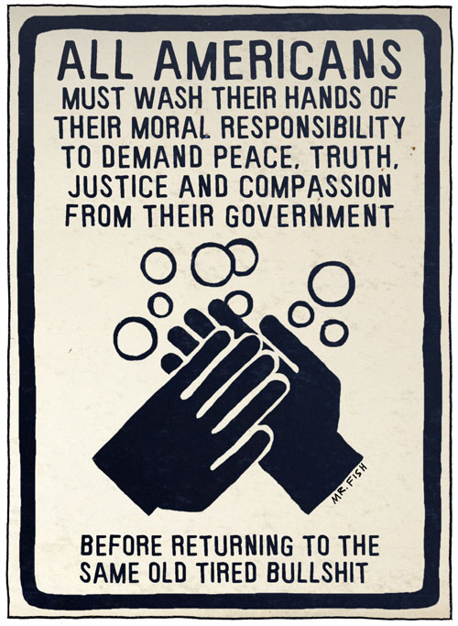
Notes:
May not be appropriate for some audiences ;]

