Slide 1

#AdvocatesCollege

Slide 2
Welcome
Debrief Homework
Framing Review and Practice
Frames
Why Values
Message Formula
Solutions
Message Box Development and Use

Slide 3
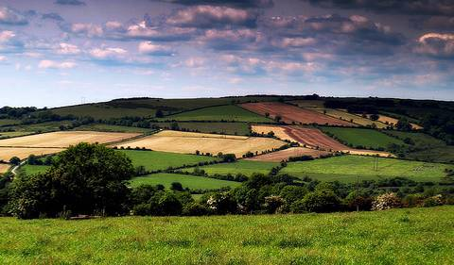

We need to change the terrain on which discussions about our issues occur

Slide 4
The importance of framing
“If they can get you asking the wrong questions, they don't have to worry about answers.”
- Thomas Pynchon,
Gravity’s Rainbow
Notes:
4

Slide 5
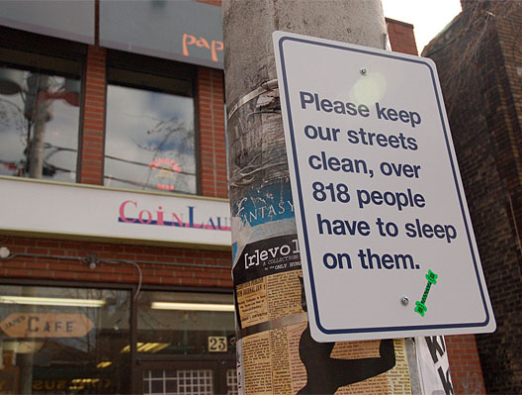

Slide 6
The importance of framing
Governor’s Fiancee Admits to Sham Green Card Marriage
Oregon’s First Lady Apologizes for Illegal Marriage in Exchange for Cash
Oregon First Lady Sorry for “Marriage of Convenience” With Green Card Seeker

Slide 7
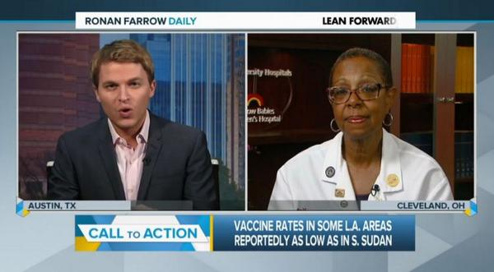

Slide 8
CITY

Slide 9
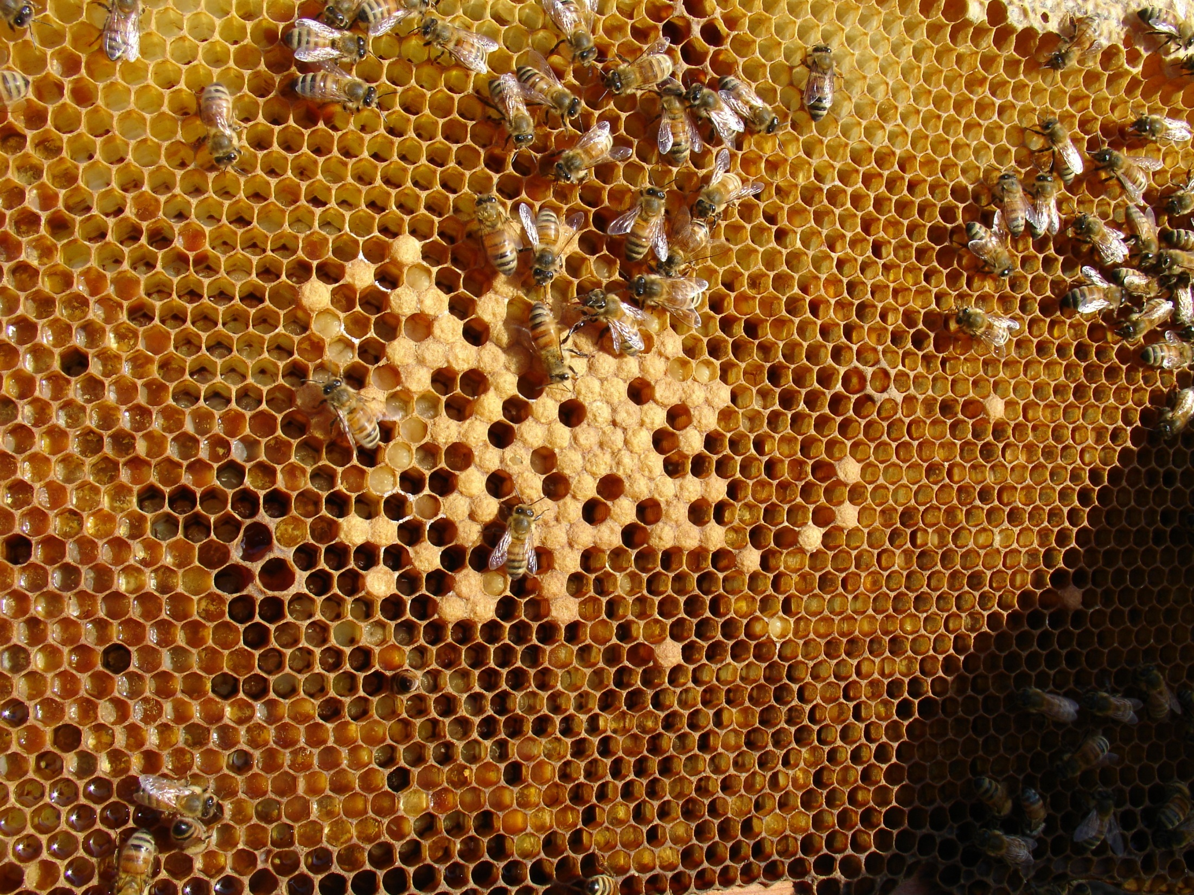
Notes:
I confess to a prejudice. I believe that Cities are the most important single unit of human society. They are to human beings what beehives are to bees. Human beings are fundamentally community beings . . . No other level of government has to face so directly the reality of how well we or poorly we work as a human community. We are bound together. The municipal leader knows it, and sees it.
Pragmatism, Prophecy, and Prayer - The Rev. B. P. Campbell, Virginia Municipal League, Prayer Breakfast, 24 October 2005

Slide 10
Frames Create Reality
“The way in which the world is imagined determines at any particular time what men will do.”
Walter Lippman, 1921

Slide 11
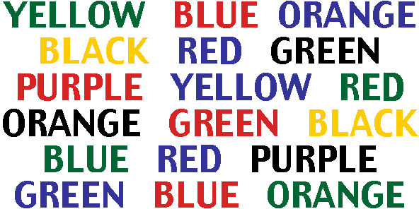

Slide 12

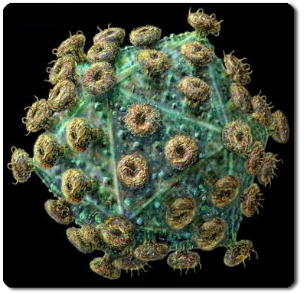
The Power of Metaphors
Facts ?

Slide 13
Speaking to Values Directs Thinking
It “reframes” because we reason based first on how something fits within our values system

Slide 14
Levels of Thinking
Level One – Big ideas:
protection, justice, family well-being,, equality, opportunity, prosperity
Level Two – Issues:
housing, the environment,, children’s issues,, workforce development
Level Three – Policies:
pay equity, bycatch,, zoning, EITC
Notes:
What do we mean by these hierarchies:
George Lakoff calls these three conceptual levels.

Slide 15
Why does this matter? Families without housing face a staggering number of obstacles. Children can suffer from poor academic performance, have higher rates of asthma, ear infections, stomach problems, and speech problems, and are at higher risk of mental and physical trauma. Parents struggling with housing security find it difficult to get and keep a job, pursue educational goals, and provide adequate care and attention to their families. By creating opportunities for families to build economic and housing security, families can build better lives and our communities will be stronger.

Slide 16
Speak to Values First
We know that communities are stronger and healthier when at-risk families get the help they need to find and stay in safe, affordable housing. With housing, families improve their childrens’ education, find stable employment, and have a deeper sense of belonging in their neighborhood. This is why the public sector should partner with nonprofit organizations and others to give every family the opportunity to have a safe and stable home.

Slide 17
Why does this matter?
“Every child should have access to immunizations but too many families in our community are not bringing their children in to our clinics. This is why we are proposing a new agency rule requiring more clinic hours . . .”

Slide 18
Speak to Values First
“The health of the whole community is protected when we ensure that our children are immunized. One of the ways we do this is through our public health agencies that provide free and low cost immunizations for all children. We need extended clinic hours to keep up with growing demands. ”

Slide 19
Values-based Vision for Ending Homelessness
Since the founding of our country, “home” has been the center of the American dream. Stable housing is the foundation upon which everything else in a family’s or individual’s life is built—without a safe, affordable place to live, it is much tougher to maintain good health, get a good education or reach your full potential.
President Obama
Opening Doors: Federal Strategic Plan to Prevent and End Homelessness
2010

Slide 20
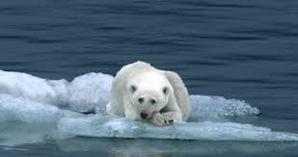

Slide 21
What’s Wrong
Why it Matters
What Can be Done
What Can be Done
Why it Matters
What’s
Wrong
Notes:
Transition – so that’s how one group told a story – I want to tell you the 4 elements of telling an effective story – first is vision
So we often use data to tell what's wrong (1 in 8 in people live in poverty) we have all the data about what's wrong – spend so little of our data on what needs to happen

Slide 22
Rolling to Solution
5% What’s Wrong
15% What’s at Stake
80% What Needs to Happen
Notes:
22

Slide 23
What is at Stake (Rolling to Solution)
We’re failing our children by letting them experience homelessness. We all want kids to succeed in school and life – for their future and ours. To succeed, they need a place to call home. We need your support for the 2013 Housing Opportunity Agenda.
/
Notes:
23

Slide 24
The Message Box
A tool to keep you “on message”
Helps distill your key arguments to the ones you need to repeat over and over.
Keeps you focused on Level One Values and Solutions
Gives you the “cheat sheet” for interviews and debates.
The place you bridge and pivot back to from hard questions and damaging frames.

Slide 25
Vision
Problem
Solution
Values

Slide 26
Your vision for the community, state, society. A sense of the purpose and goal that drives you to seek the change you are working for. Your aspiration and inspiration.
A clear statement of the problem you are trying to address in a way that everyone can see their stake in addressing the issue.
The solution you are proposing and the principles or outcomes it is designed to achieve.
Vision
Problem
Solution
Values
The Level One Values that underpin the challenge and your proposed solution. The answer to the “why does it matter” question.

Slide 27
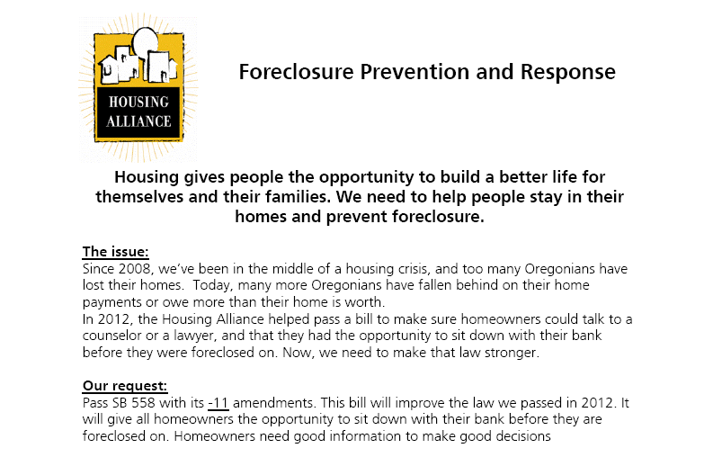
Making it Easy
Vision/Values
Problem
Solution

Slide 28
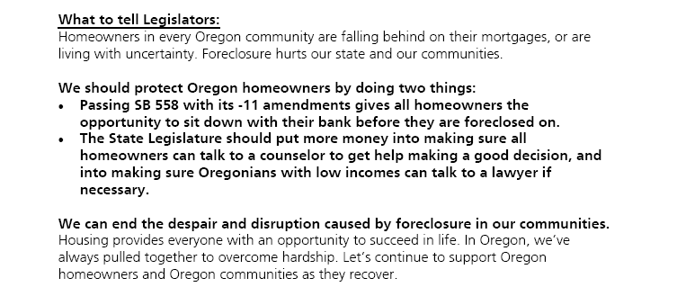
Making it Easy
Say this!
Solution
Vision/Values

Slide 29
Writing a Letter to the Editor
Keep it short: 3 to 4 paragraphs (150-250 words; check requirements)
Respond quickly
Mention the reason for the letter in the first sentence
Limit the contents to 1 or 2 key points
Say why it matters (Values), specify what needs to be done (Policy), and ask those with the power to make it happen to act (Responsibility)
Use framed messages, social math, and simplifying models
Include name, address, & phone number
Adapted from BMSG

Slide 30
Safety Phrases and Pivot Phrases
Safety Phrase
To have “on reserve” in the event that you get tangled or forget where you were headed; a phrase that will always bring you back to your main point.
Pivot Phrase
When the dialogue is headed off-point, a phrase that will transition back to the direction you were initially headed. Acknowledge without reinforcing the opposing frame, and redirect.
Note that these can be similar, or even the same.
Develop your phrases with your overall strategy in mind.

Slide 31
Safety & Pivot Phrases
The important thing to remember is…..
What we are talking about here is….
What matters most is…
To put this in broader perspective…
The larger issue is…
I would like to emphasize that…
Let’s not lose sight of the core problem….
At the heart of the matter is…
Taking a closer look what we see is….
At the end of the day, none of those issues can be addressed without…
BMSG 1999; WHO 2005

