Slide 1
IDA Initiative– Crafting a Mission for the Next 20 Years
2022 RE:Conference
Notes:
Speaker: Alicia
Happy to have you here - we are from United Way of Greater Philadelphia and Neighborhood Partnerships to facilitate a workshop on Emergency Savings, the Power of Narrative, and Revisioning IDAs
Introduce myself

Slide 2
Table Conversations
Name, Position, Organization
What is a takeaway from this conference about narratives that you will be incorporating into your work?
Notes:
Speaker: Alicia

Slide 3
Today’s Objectives & Agenda
Expansion of vision
Strengths and opportunities
Past IDA narratives
Crafting an IDA mission
3pm: have a safe trip home!
Notes:
Speaker: Alicia

Slide 4
1999
Must have earned income to qualify
Use of custodial accounts
A regular monthly savings requirement
Emergency withdrawals limited to qualifying emergencies
An asset-based anti- poverty demonstration project

Slide 5
Expansion of Vision
1999
2015
2017
2019
IDAs Begin in Oregon paired with AFI funding
Oregon expands asset classes in statute
AFI stops being funded
2019 human- centered design at RE:Conference

Slide 6
2019 RE:Conference
Identifying how to better measure equity impact
Trying new approaches
Building trust & confidence in clients and community
Changing the language we use
Getting out of the way, and reducing gatekeepers
How might Black, Indigenous, and People of Color in Oregon gain access to assets?

Slide 7
2020-21
Emergency Savings added along with “vision” changes to IDA Statute
Investment through an IDA will help lower income households obtain the assets they need to succeed. Communities and this state will experience resultant economic and social benefits accruing from the promotion of the financial stability and resilience of lower income households.
Notes:
Speaker: Luke

Slide 8
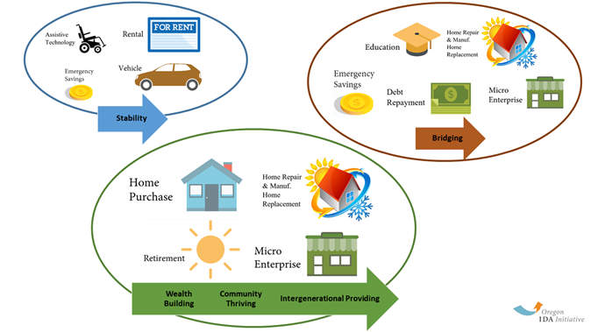

Slide 9
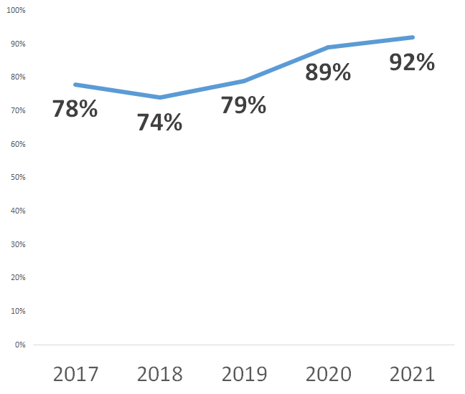
With new tools available, the % of participants who complete their IDA with match $ has increased

Slide 10
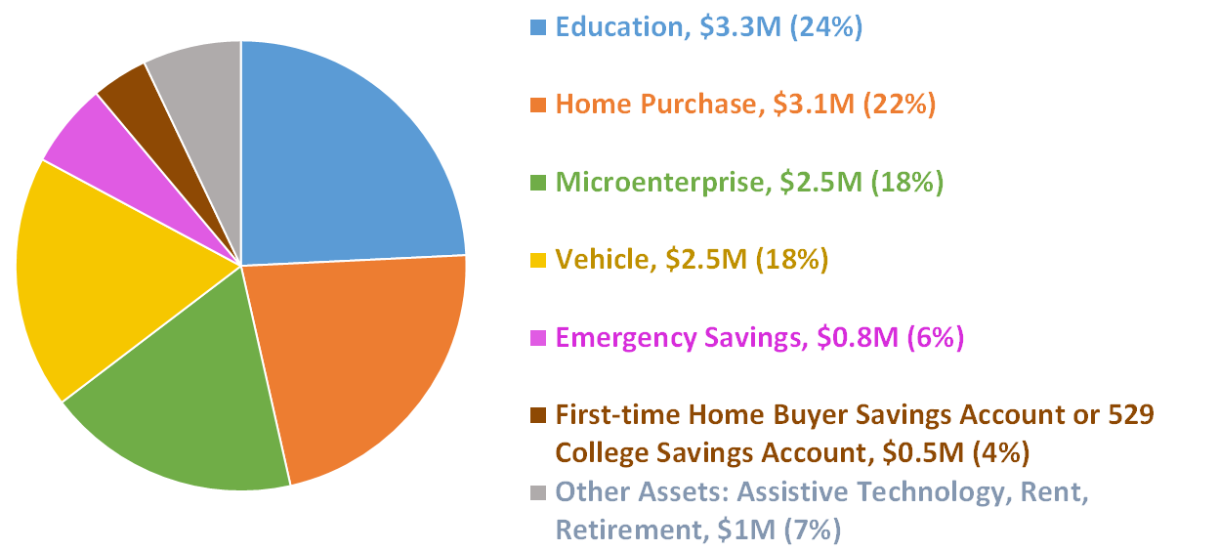
Oregon households use IDAs to accomplish a variety of financial stability and asset-building goals

Slide 11
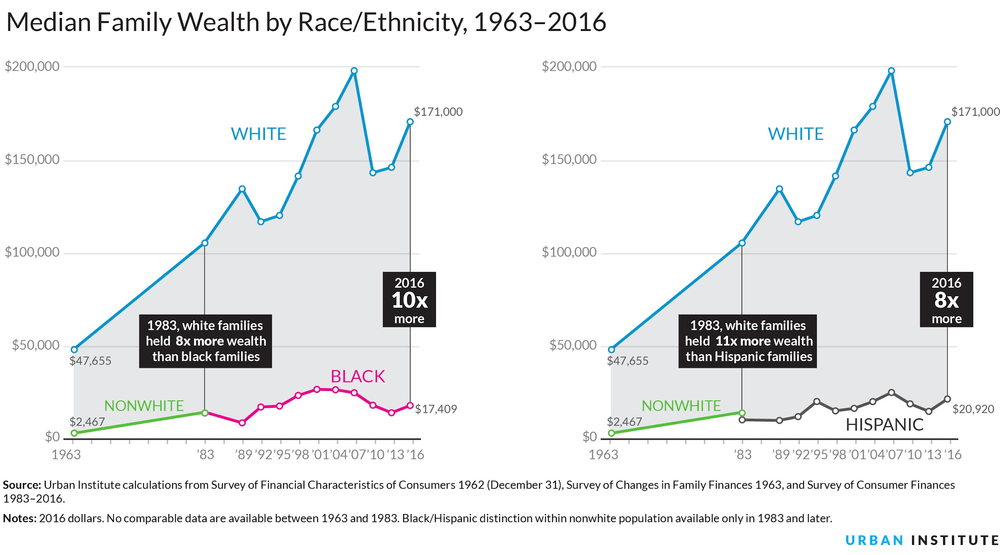
We know from history and data that communities of color have been and continue to be underserved, exploited, oppressed, and excluded by financial systems and institutions.

Slide 12
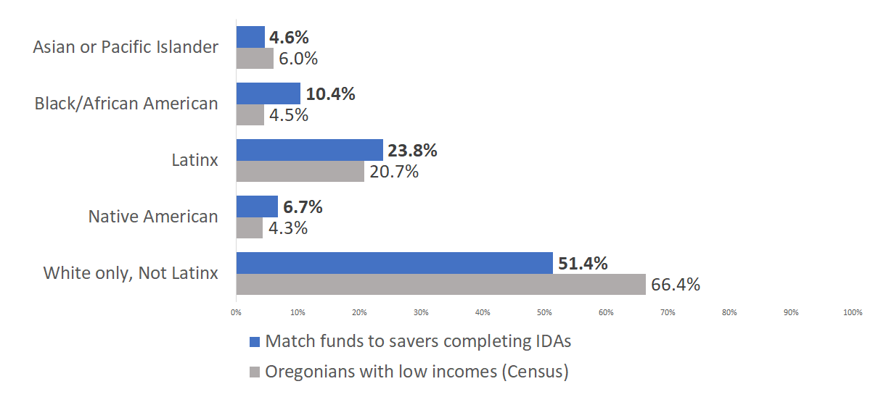
Match is distributed to Black, Native American participants
at rates that can support greater equity

Slide 13
IDA Mission
What is our purpose?
How do IDAs get us to our vision?
What work are we good at and excited about?

Slide 14
IDAs are matched savings accounts that build the financial management skills of qualifying Oregonians with lower incomes while they save towards a defined goal.
—
IDAs are matched savings accounts that change the financial futures of qualifying Oregonians with lower incomes. Participants build financial skills such as budgeting and saving while they save towards a defined goal, and for every dollar they save the Initiative typically matches three dollars.
What are some harmful narratives embedded in these?

Slide 15
IDA Mission
What is our purpose?
How do IDAs get us to our vision?
What work are we good at and excited about?

Slide 16
Oregonians with low to moderate incomes leverage matching money from Individual Development Accounts (IDAs) to increase the power of their own savings in support of their financial goals. IDA providers partner with participants, offering community-based support, information about financial systems, and matching cash towards financial stability and wealth building.

Slide 17
Questions for discussion
Table Groups of 5-6 tinyurl.com/4wutsj5n
How does this mission center the saver and their lived experiences?
How might this mission be changed to align with our goal of decreasing the racial wealth gap in Oregon?
If you are an IDA Provider: How does this statement align with your program?

Slide 18
Notes
How does this mission center the saver and their lived experiences?
Add notes here…

Slide 19
Notes
How might this mission be changed to align with our goal of decreasing the racial wealth gap in Oregon?
Add notes here…

Slide 20
Notes
If you are an IDA Provider: How does this statement align with your program?
Add notes here…

Slide 21
Thank you for coming to RE:Conference!
Notes:
Speaker: Alicia
Happy to have you here - we are from United Way of Greater Philadelphia and Neighborhood Partnerships to facilitate a workshop on Emergency Savings, the Power of Narrative, and Revisioning IDAs
Introduce myself

