Slide 2
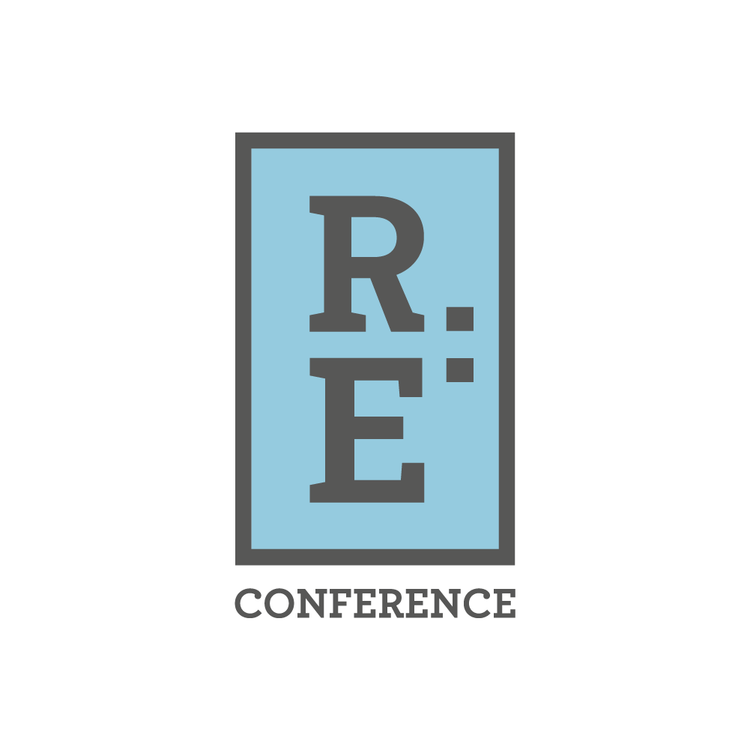
Community Centered Perspectives on Wealth: Building and Shifting Power through Community-centered Research and Narrative in Oregon
Jessica Santos, Director, Leah Zallman Center for Immigrant Health Research
Dr. Mira Mohsini, Senior Researcher, Coalition of Communities of Color
Nancy Ramirez Arriaga, Program Officer, Meyer Memorial Trust
Oscar Arana, Community Development Director, Native American Youth & Family Center (NAYA)

Slide 3
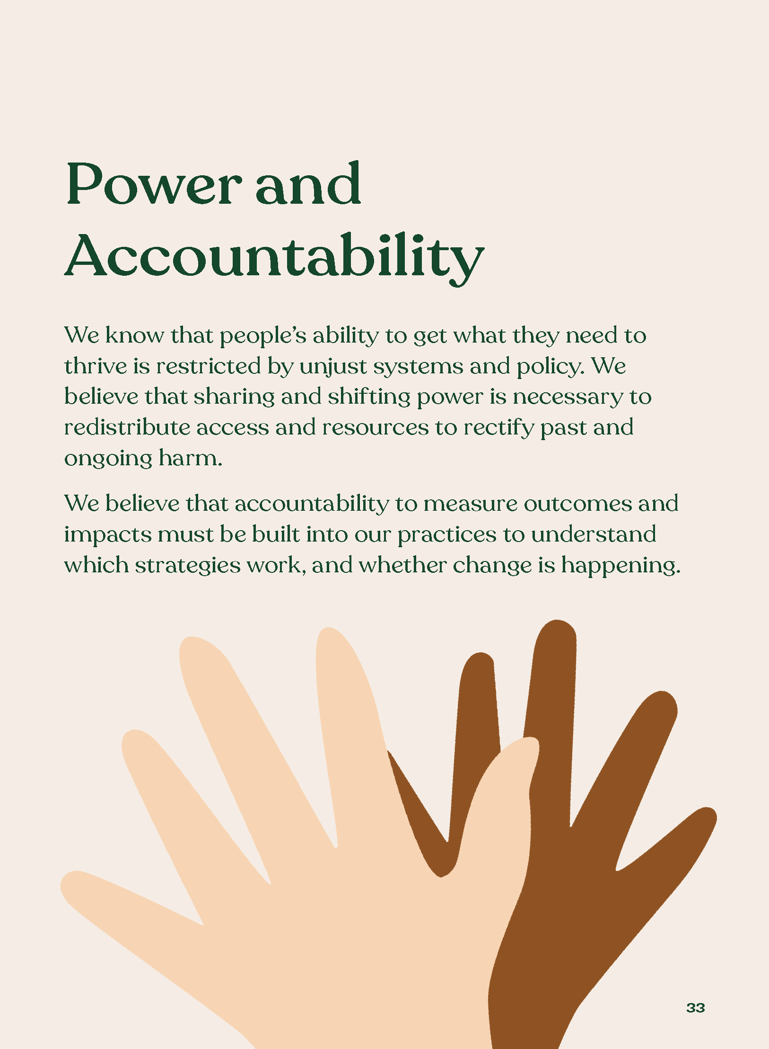
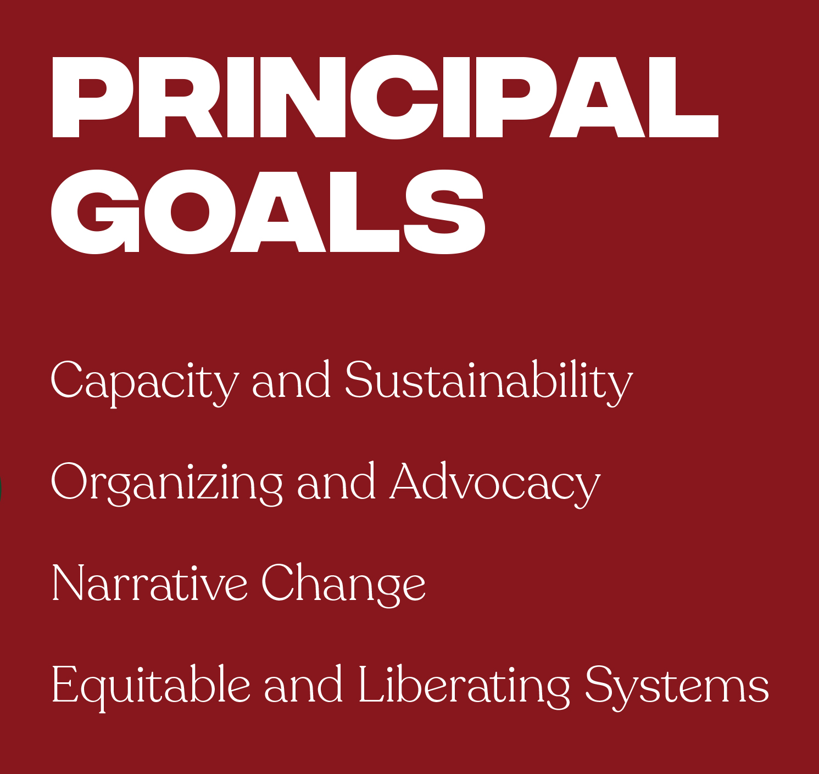

Slide 4
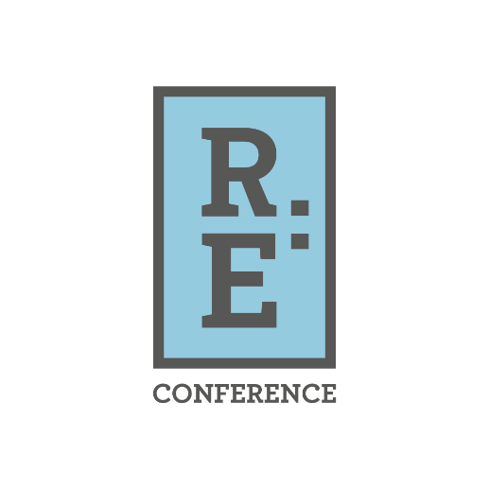
What's Next? 10:45 Sessions
Willamette Ballroom A:
Land for Community, Not Profit
Willamette Ballroom B:
Narrative Change through Graphic Novels & Zines
Willamette Ballroom C/D:
The Power of Cash

